Slide 1
Data Mining Cluster Analysis: Basic Concepts and Algorithms
Lecture Notes for Chapter 7
Introduction to Data Mining

Slide 2
What is Cluster Analysis?
Given a set of objects, place them in groups such that the objects in a group are similar (or related) to one another and different from (or unrelated to) the objects in other groups
Inter-cluster distances are maximized
Intra-cluster distances are minimized

Slide 3
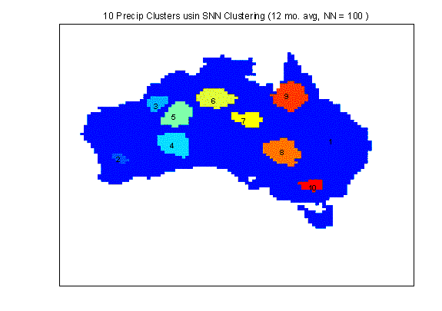
Applications of Cluster Analysis
Understanding
Group related documents for browsing, group genes and proteins that have similar functionality, or group stocks with similar price fluctuations
Summarization
Reduce the size of large data sets
Clustering precipitation in Australia

Slide 4
Notion of a Cluster can be Ambiguous
How many clusters?
Six Clusters
Two Clusters
Four Clusters

Slide 5
Types of Clusterings
A clustering is a set of clusters
Important distinction between hierarchical and partitional sets of clusters
Partitional Clustering
A division of data objects into non-overlapping subsets (clusters)
Hierarchical clustering
A set of nested clusters organized as a hierarchical tree

Slide 6
Partitional Clustering
Original Points
A Partitional Clustering

Slide 7
Hierarchical Clustering
Traditional Hierarchical Clustering
Traditional Dendrogram
Non-traditional Hierarchical Clustering
Non-traditional Dendrogram

Slide 8
Other Distinctions Between Sets of Clusters
Exclusive versus non-exclusive
In non-exclusive clusterings, points may belong to multiple clusters.
Can belong to multiple classes or could be ‘border’ points
Fuzzy clustering (one type of non-exclusive)
In fuzzy clustering, a point belongs to every cluster with some weight between 0 and 1
Weights must sum to 1
Probabilistic clustering has similar characteristics
Partial versus complete
In some cases, we only want to cluster some of the data

Slide 9
Clustering Algorithms
K-means and its variants
Hierarchical clustering
Density-based clustering

Slide 10
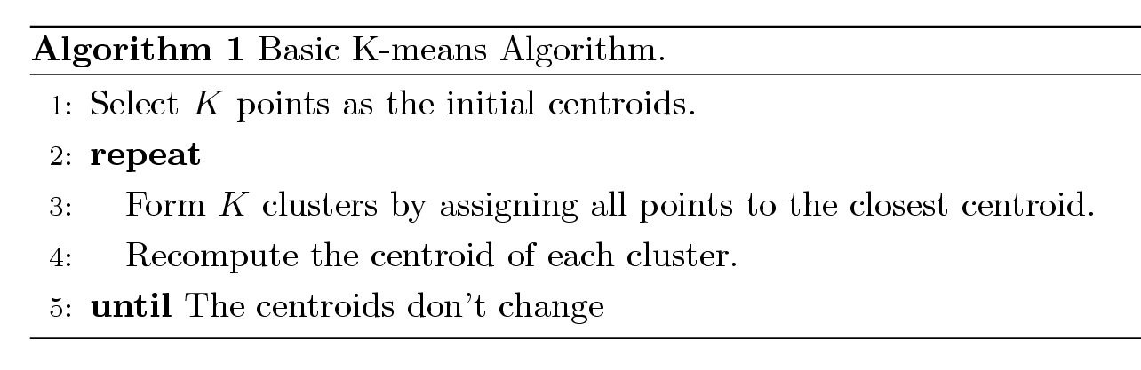
K-means Clustering
Number of clusters, K, must be specified
Each cluster is associated with a centroid (center point)
Each point is assigned to the cluster with the closest centroid
The basic algorithm is very simple

Slide 11
Example of K-means Clustering

Slide 12
Example of K-means Clustering

Slide 13
K-means Clustering – Details
Choose initial centroids;
repeat {assign each point to a nearest centroid; re-compute cluster centroids}
until centroids stop changing.
Initial centroids are often chosen randomly.
Clusters produced can vary from one run to another
The centroid is (typically) the mean of the points in the cluster, but other definitions are possible
K-means will converge for common proximity measures with appropriately defined centroid
Most of the convergence happens in the first few iterations.
Often the stopping condition is changed to ‘Until relatively few points change clusters’
Complexity is O( n * K * I * d )
n = number of points, K = number of clusters, I = number of iterations, d = number of attributes

Slide 14
Example
A1(2, 10), A2(2, 5), A3(8, 4), A4(5, 8), A5(7, 5), A6(6, 4), A7(1, 2), A8(4, 9)
Initial cluster centers are: A1(2, 10), A4(5, 8) and A7(1, 2)
The distance function between two points a = (x1, y1) and b = (x2, y2) is defined as-
Ρ(a, b) = |x2 – x1| + |y2 – y1|

Slide 15
Iteration 1
We calculate the distance of each point from each of the center of the three clusters.
The distance is calculated by using the given distance function.
Ρ(A1, C1)
= |x2 – x1| + |y2 – y1|
= |2 – 2| + |10 – 10|
= 0

Slide 16
Iteration 1 - Continued
Ρ(A1, C2)
= |x2 – x1| + |y2 – y1|
= |5 – 2| + |8 – 10|
= 3 + 2
= 5

Slide 17
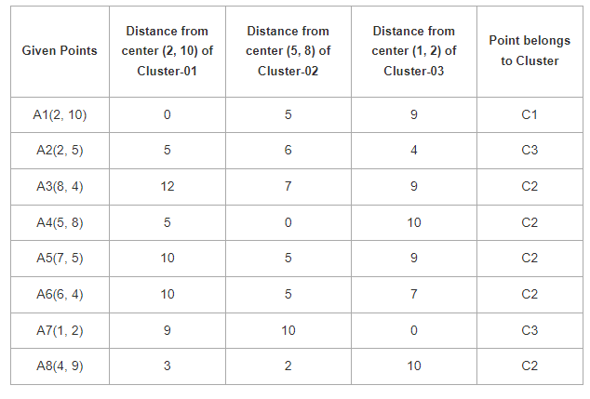
Iteration 1 - Continued

Slide 18
Centroid Update
First cluster contains points-
A1(2, 10)
Second cluster contains points-
A3(8, 4)
A4(5, 8)
A5(7, 5)
A6(6, 4)
A8(4, 9)

Slide 19
Centroid Update
Third cluster contains points
A2(2, 5)
A7(1, 2)
We re-compute the new cluster clusters.
The new cluster center is computed by taking mean of all the points contained in that cluster.

Slide 20
Centroid Update
For Cluster-01:
We have only one point A1(2, 10) in Cluster-01.
So, the cluster center remains the same.
For Cluster-02
= ((8 + 5 + 7 + 6 + 4)/5, (4 + 8 + 5 + 4 + 9)/5)
= (6, 6)
For Cluster-03
= ((2 + 1)/2, (5 + 2)/2)
= (1.5, 3.5)

Slide 21
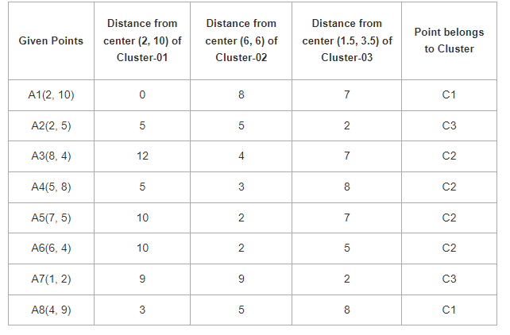
Iteration 2

Slide 22
Centroid Update
Cluster 01 points
A1(2, 10)
A8(4, 9)
Cluster 02 points
A3(8, 4)
A4(5, 8)
A5(7, 5)
A6(6, 4)

Slide 23
Centroid Update
Third cluster contains points-
A2(2, 5)
A7(1, 2)
Center of Cluster-01
= ((2 + 4)/2, (10 + 9)/2)
= (3, 9.5)

Slide 24
Centroid Update
Center of Cluster-02
= ((8 + 5 + 7 + 6)/4, (4 + 8 + 5 + 4)/4)
= (6.5, 5.25)
Center of Cluster-02
= ((8 + 5 + 7 + 6)/4, (4 + 8 + 5 + 4)/4)
= (6.5, 5.25)

Slide 25
Final Centers
After second iteration, the center of the three clusters are-
C1(3, 9.5)
C2(6.5, 5.25)
C3(1.5, 3.5)

Slide 26
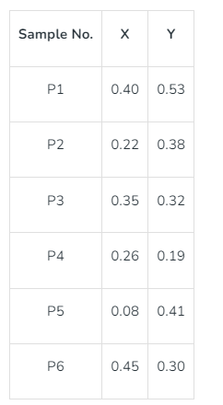
Agglomerative Clustering Example: Single Link

Slide 27
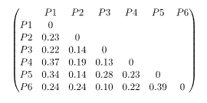
First Merge d(p1, p2) = sqrt( (X-a)^2 + (y-b)^2)
Merge P6 and P3

Slide 28
Recalculate Distance
min ((P3,P6), P1) = min ((P3,P1), (P6,P1)) = min (0.22,0.24) = 0.22
min ((P3,P6), P2) = min ((P3,P2), (P6,P2)) = min (0.14,0.24) = 0.14
min ((P3,P6), P4) = min ((P3,P4), (P6,P4)) = min (0.13,0.22) = 0.13
min ((P3,P6), P5) = min ((P3,P5), (P6,P5)) = min (0.28,0.39) = 0.28

Slide 29
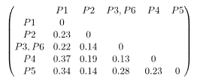
Updated Distance Matrix
Merge P4 and P3,P6

Slide 30
Repeat
min (((P3,P6) P4), P1) = min (((P3,P6), P1), (P4,P1)) = min (0.22,0.37) = 0.22
min (((P3,P6), P4), P2) = min (((P3,P6), P2), (P4,P2)) = min (0.14,0.19) = 0.14
min (((P3,P6), P4), P5) = min (((P3,P6), P5), (P4,P5)) = min (0.28,0.23) = 0.23

Slide 31
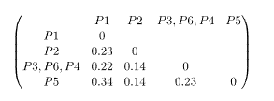
Update Distance Matrix
Merge P2 and P5

Slide 32
Recalculate Distance
min ((P2,P5), P1) = min ((P2,P1), (P5,P1)) = min (0.23, 0.34) = 0.23
min ((P2,P5), (P3,P6,P4)) = min ((P3,P6,P4), (P3,P6,P4)) = min (0.14. 0.23) = 0.14

Slide 33

Update Distance Matrix
Merge P3,P6,P4 and P2, P5

Slide 34
Recalculate Distance
min ((P2,P5,P3,P6,P4), P1) = min ((P2,P5), P1), ((P3,P6,P4), P1)) = min (0.23, 0.22) = 0.22

Slide 35

Final Matrix

Slide 36
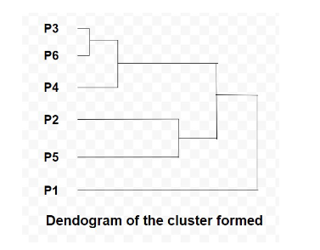
Dendogram

Slide 37
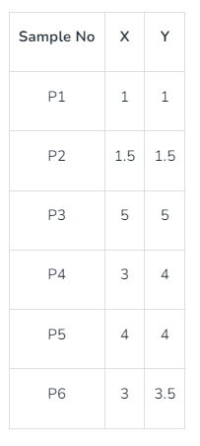
Agglomerative Clustering Example: Complete Link

Slide 38
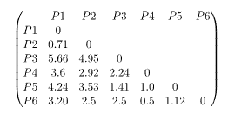
Distance Matrix

Slide 39
Update Distance Matrix
max (d(P4,P6), P1) = max (d(P4,P1), d(P6,P1)) = max (3.6, 3.2) = 3.6
max (d(P4,P6), P2) = max (d(P4,P2), d(P6,P2)) = max (2.92, 2.5) = 2.92
max (d(P4,P6), P3) = max (d(P4,P3), d(P6,P3)) = max (2.24, 2.5) = 2.5
max (d(P4,P6), P5) = max (d(P4,P5), d(P6,P5)) = max (1.0, 1.12) = 1.12

Slide 40
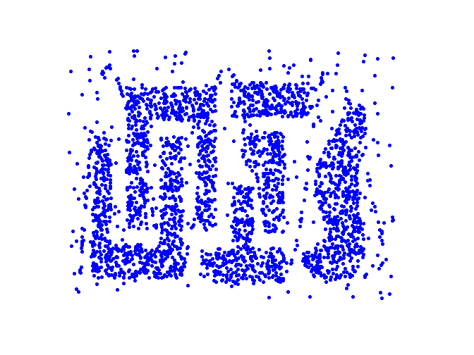
Density Based Clustering
Clusters are regions of high density that are separated from one another by regions on low density.

Slide 41
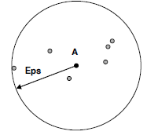
DBSCAN
DBSCAN is a density-based algorithm.
Density = number of points within a specified radius (Eps)
Notes:
In the center-based approach, density is estimated for a particular point in
the data set by counting the number of points within a specified radius, Eps,
of that point. This includes the point itself. This technique is graphically
illustrated by Figure 8.20. The number of points within a radius of Eps of
point A is 7, including A itself.
This method is simple to implement, but the density of any point will
depend on the specified radius. For instance, if the radius is large enough,
then all points will have a density of m, the number of points in the data set.
Likewise, if the radius is too small, then all points will have a density of 1.
An approach for deciding on the appropriate radius for low-dimensional data
is given in the next section in the context of our discussion of DBSCAN.

Slide 42
DBSCAN
A point is a core point if it has at least a specified number of points (MinPts) within Eps
These are points that are at the interior of a cluster
Counts the point itself
A border point is not a core point, but is in the neighborhood of a core point
A noise point is any point that is not a core point or a border point
Notes:
Core points: These points are in the interior of a density-based cluster. A
point is a core point if the number of points within a given neighborhood
around the point as determined by the distance function and a userspecified
distance parameter, Eps, exceeds a certain threshold, MinPts,
which is also a user-specified parameter. In Figure 8.21, point A is a
core point, for the indicated radius (Eps) if MinPts ≤ 7.
Border points: A border point is not a core point, but falls within the neighborhood
of a core point. In Figure 8.21, point B is a border point. A
border point can fall within the neighborhoods of several core points.
Noise points: A noise point is any point that is neither a core point nor a
border point. In Figure 8.21, point C is a noise point.

Slide 43
DBSCAN: Core, Border, and Noise Points
MinPts = 7

Slide 44
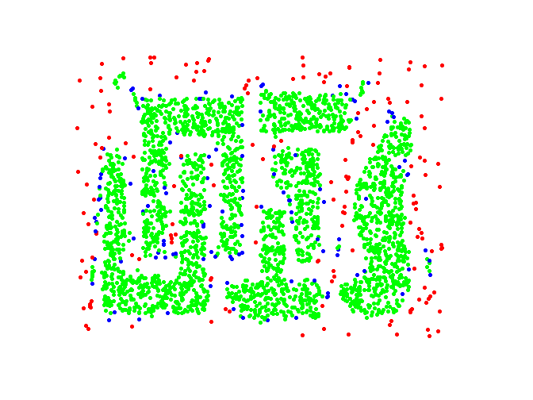
DBSCAN: Core, Border and Noise Points
Original Points
Point types: core, border and noise
Eps = 10, MinPts = 4

Slide 45
DBSCAN
Given the previous definitions of core points, border points, and noise points, the DBSCAN algorithm can be informally described as follows. Any two core points that are close enough—within a distance, Eps of one another—are put in the same cluster. Likewise, any border point that is close enough to a core point is put in the same cluster as the core point. (Ties may need to be resolved if a border point is close to core points from different clusters.) Noise points are discarded.

Slide 46
DBSCAN Algorithm
Form clusters using core points, and assign border points to one of its neighboring clusters
1: Label all points as core, border, or noise points.
2: Eliminate noise points.
3: Put an edge between all core points within a distance Eps of each other.
4: Make each group of connected core points into a separate cluster.
5: Assign each border point to one of the clusters of its associated core points

Slide 47
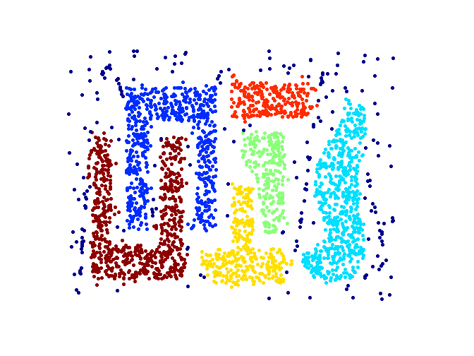
When DBSCAN Works Well
Original Points
Clusters (dark blue points indicate noise)
Can handle clusters of different shapes and sizes
Resistant to noise

Slide 48
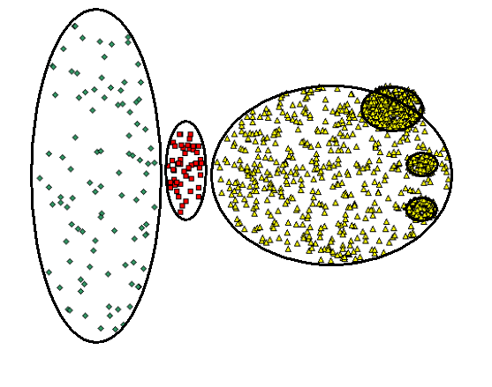
When DBSCAN Does NOT Work Well
Original Points

Slide 49
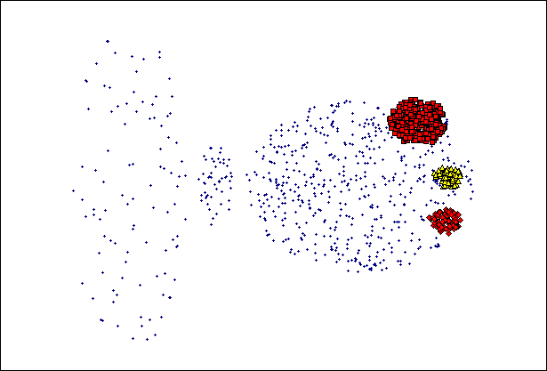
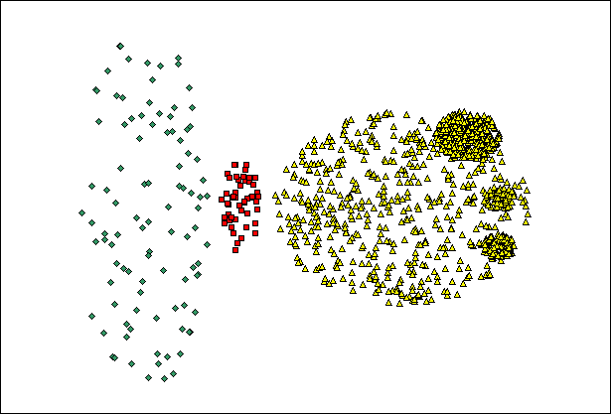
When DBSCAN Does NOT Work Well
(MinPts=4, Eps=9.92).
Original Points
Varying densities
High-dimensional data
(MinPts=4, Eps=9.75)

Slide 50
Cluster Validity
For supervised classification we have a variety of measures to evaluate how good our model is
Accuracy, precision, recall
For cluster analysis, the analogous question is how to evaluate the “goodness” of the resulting clusters?
But “clusters are in the eye of the beholder”!
In practice the clusters we find are defined by the clustering algorithm
Then why do we want to evaluate them?
To avoid finding patterns in noise
To compare clustering algorithms
To compare two sets of clusters
To compare two clusters

Slide 51
Clusters found in Random Data
Random Points
DBSCAN
K-means
Complete Link

Slide 52
Measures of Cluster Validity
Numerical measures that are applied to judge various aspects of cluster validity, are classified into the following two types.
Supervised: Used to measure the extent to which cluster labels match externally supplied class labels.
Entropy
Often called external indices because they use information external to the data
Unsupervised: Used to measure the goodness of a clustering structure without respect to external information.
Sum of Squared Error (SSE)
Often called internal indices because they only use information in the data
You can use supervised or unsupervised measures to compare clusters or clusterings

Slide 53
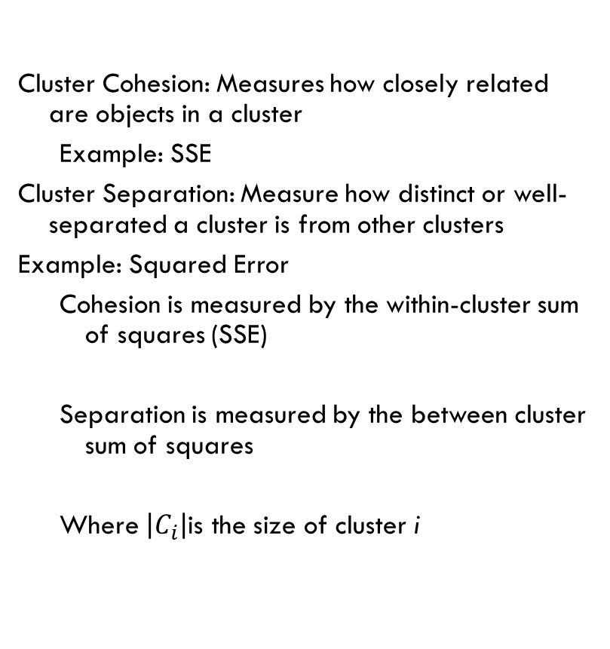

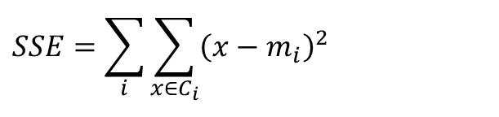
Unsupervised Measures: Cohesion and Separation
Cluster Cohesion: Measures how closely related are objects in a cluster
Example: SSE
Cluster Separation: Measure how distinct or well-separated a cluster is from other clusters
Example: Squared Error
Cohesion is measured by the within-cluster sum of squares (SSE)
Separation is measured by the between cluster sum of squares
Where $\left|C_{i}\right|$is the size of cluster i
$$SSE=\sum_{i}{\sum_{x∈C_{i}}{{\left(x−m_{i}\right)}^{2}}}$$
$$SSB=\sum_{i}{\left|C_{i}\right|{\left(m−m_{i}\right)}^{2}}$$

Slide 54



Unsupervised Measures: Cohesion and Separation
Example: SSE
SSB + SSE = constant
m
×
×
×
1
m₁
2
3
4
m₂
5
K=1 cluster:
$$SSE={\left(1−3\right)}^{2}+{\left(2−3\right)}^{2}+{\left(4−3\right)}^{2}+{\left(5−3\right)}^{2}=10$$
$$SSB=4×{\left(3−3\right)}^{2}=0$$
$$Total=10+0=10$$
K=2 clusters:
$$SSE={\left(1−1.5\right)}^{2}+{\left(2−1.5\right)}^{2}+{\left(4−4.5\right)}^{2}+{\left(5−4.5\right)}^{2}=1$$
$$SSB=2 ×{\left(3−1.5\right)}^{2}+2×{\left(4.5−3\right)}^{2}=9$$
$$Total=1+9=10$$

